Slide 1
Linda Coordination Language
Presented by
Tae Ki Kim
Tae@udel.edu

Slide 2
Outline
Linda
C-Linda
Java Space

Slide 3
Linda
Parallel coordination language
Virtual shared memory system on heterogeneous networks
Associative addressing through efficient hashing
Simple language primitives allow minimal code rewriting:
  In(), Out() moves “tuples” to/from TupleSpace
  Eval() spawns processes in Tuplespace
  Rd() does non-destructive reads in T.S.
  Inp(), Rdp() are non-blocking versions of In() and Rd()

Slide 4
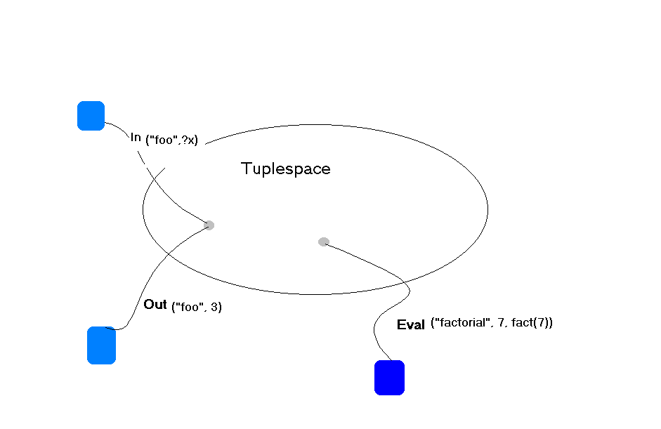
Tuplespace

Slide 5
C-Linda Language
The C-Linda programming language is the combination of the C and the Linda language.
The C-Linda is one realization of the Linda model.
The C-Linda supports six Linda functions.

Slide 6
C-Linda Functions
Out(t) – causes tuple t to be added to tuple space
    Out(“a string”, 15.01, 17, x)
    Out(0, 1)
In(s) – causes some tuple t that matches anti-tuple s to be withdrawn from tuple space.
    In(“a string”, ? F, ? I, y)

Slide 7
C-Linda Functions
Rd(s) is the same as in(s) except that the matched tuple remains in tuple space.
Eval(t) is the same as out(t), except that it sends an active tuple into Tuplespace.
  For example,
    out(“foo”, 3, 4.3)
    Eval(“factorial”, 7, fact(7))

Slide 8
C-Linda Functions
Inp and Rdp – predicate versions of in and rd, attempt to locate a matching tuple and return 0 if they fail; otherwise they return 1.

Slide 9
Example of Tuple matching
N-element vector stored as n tuples in the Tuple space
(“V”, 1, FirstElt)
(“V”, 2, SecondElt)
…
(“V”, n, NthElt)
To read the jth element and assign it to x, use
Rd(“V”, j, ?x)

Slide 10
/* hello.clc: a simple C-Linda program */
#include "linda.h"
int worker(int num) {
int i;
for (i=0; i<num; i++)
out("hello, world");
return 0;
}
int real_main(int argc, char *argv[]) {
int result;
eval("worker", worker(5));
in("hello, world");
in("hello, world");
in("hello, world");
in("hello, world");
in("hello, world");
in("worker", ? result);
return 0;
}

Slide 11
Benefits of C-Linda
Anonymous and asynchronous communication
Associative addressing / pattern matching
Data persistence independent of creator
Simple API → less and easier coding
Ease of code transformation

Slide 12
C-Linda Limitations
High system overhead
Designed as parallel computing model, primarily for LANs
  Lack of security model
  Lack of transaction semantics
Language specific implementation
Blocking calls, but no notification mechanism

Slide 13
JavaSpaces (Sun Micro)
Lightweight infrastructure for network applications
Distributed functionality implemented through RMI
Entries written to/from JavaSpace with “write, read”
“notify” notifies client of incoming entries w/ timeout

Slide 14
JavaSpace
Pattern Matching done to templates with class type comparisons, no comparison of literals.
Transaction mechanism with a two phase commit model
Entries are writtern with a “lease”, so limited persistence with time-outs.

Slide 15
package examples.spaces;
import net.jini.impl.outrigger.binders.RefHolder;
import net.jini.lease.Lease;
import net.jini.space.JavaSpace;
import net.jini.transaction.Transaction;
import java.rmi.Naming;
import java.rmi.RMISecurityManager;
public class HelloWorld {
/** * Get a remote reference to a particular space */
public JavaSpace getSpace() {
try {
// RefHolderImpl is the remote object registered with
// the registry
//
RefHolder rh = (RefHolder)Naming.lookup("JavaSpace");
// Use the RefHolder's proxy method to get the space
// reference
//
JavaSpace js = (JavaSpace)rh.proxy();
return js;
} catch (Exception e) {
System.err.println(e.getMessage());
}
return null;
}

Slide 16
public static void main(String [] args) {
// Set a security manager so that the MyEntry class
// can be downloaded from this codebase to the server
//
if (System.getSecurityManager() == null) {
System.setSecurityManager(new RMISecurityManager());
}
// Create an instance of this class to call the getSpace
// method
JavaSpace space = (new HelloWorld()).getSpace();
System.out.println("Got a remote reference" + "to a JavaSpace implementation");
//Create an Entry to write in to the space
//
MyEntry msg = new MyEntry();
msg.content = "Howdy";

Slide 17
// The transaction under which to perform the write
//
Transaction txn = null;
// The lease duration that should be requested for
// this entry
long timeToLive = Lease.FOREVER;
try {
space.write(msg, txn, timeToLive);
System.out.println("Wrote an Entry to the space");
MyEntry template = new MyEntry();
// Set attribute to be null, so it will act as a
// wildcard and match on any MyEntry
//
template.content = null;
System.out.println("Created a template");

Slide 18
// The amount of time to wait for a match
//
long timeToWait = 0L;
// The transaction under which to perform the read
//
Transaction sotxn = null;
MyEntry result = (MyEntry) space.read (template, sotxn, timeToWait);
System.out.println("Read the an Entry from the space");
String valueToPrint = "";
valueToPrint = result.content;
System.out.println("And the result was: " + valueToPrint);
} catch (Exception e) {
e.printStackTrace(System.err);
}
System.exit(0);
}
}

Slide 19
JavaSpace Limitations
Simplicity of or lack of security model
Java RMI = performance bottleneck
Currently only a specification exists, but no implementation

Slide 20
More Tuple Space Implemetations
Java Messaging Service(JMS), a Message-Oriented Middleware (MOM) layer API, shares many of the same architectural strengths of JavaSpaces while offering some added benefits.
Tspaces (IBM Almaden)
PageSpace and JADA
LIME
XML Dataspaces
Mobile Agent Reactive Space(MARS)

Slide 21
Conclusion
"Space-based" architectures are extremely flexible, providing most of the core infrastructure necessary to support distributed, mobile, and intelligent software agents.
The language is although intuitive, but minimal Security.
Linda is not fault-tolerant

